Slide 1
The Six Wives of Henry VIII
Danielle Berube
berubed89@yahoo.com
Introduction to Information Science and Technology
ILS 501-S70

Slide 2
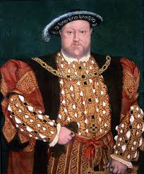
Henry VIII
Born June 28, 1491 to Henry VII and Elizabeth of York
Became king on June 24, 1509
Henry VIII is most famous for
His break with the Catholic Church and establishing himself as Head of the Church of England
For his six marriages.
Had three children: Mary I, Elizabeth I, and Edward VI
Died January 28, 1547 at the age of 55

Slide 3
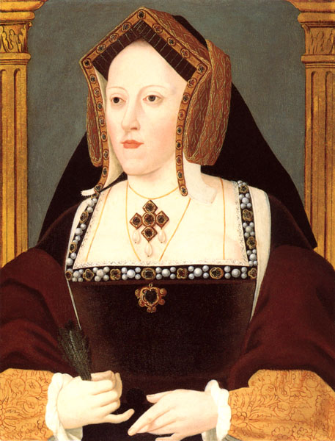
Catherine of Aragon
Born December 16, 1485 to Ferdinand II of Aragon and Isabella I of Castile
Came to England in 1501 to marry the future king of England Arthur Prince of Wales who later died in 1503
Married Arthur’s brother Henry VIII in 1509
Had one daughter Mary (the future Mary I) in 1516
Due to the fact that Catherine was unable to give Henry VIII a son he had their marriage annulled in 1533
Died January 7, 1536 at the age of 51
Notes:
Catherine had eight pregnancies throughout her 24 year marriage to Henry, but only Mary survived to adulthood

Slide 4
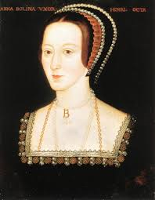
Anne Boleyn
Born 1501 to Thomas and Elizabeth Boleyn
Began seeing Henry while he was still married to Catherine
Married Henry VIII on January 1533
Had one daughter Elizabeth (the future Elizabeth I) in 1533
Was not well liked by the people of England and tried without success to give Henry VIII a male heir
Executed: May 19, 1536 for adultery at the age of 35
Notes:
Rumored to be a witch by her adversaries at court

Slide 5
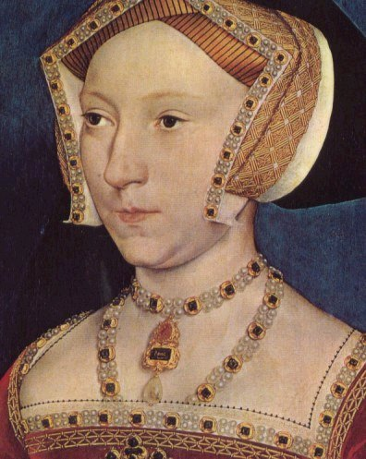
Jane Seymour
Born 1508/1509 to John Seymour and Margery Wentworth
Served as lady in waiting to Catherine of Aragon and Anne Boleyn
Married Henry VIII on May 30, 1536 just days after Anne Boleyn's death
Gave birth to Henry VIII’s only son Edward (the future Edward VI)
Died October 24, 1537 at the age of 28/29
Notes:
The only wife to be buried with Henry VIII

Slide 6
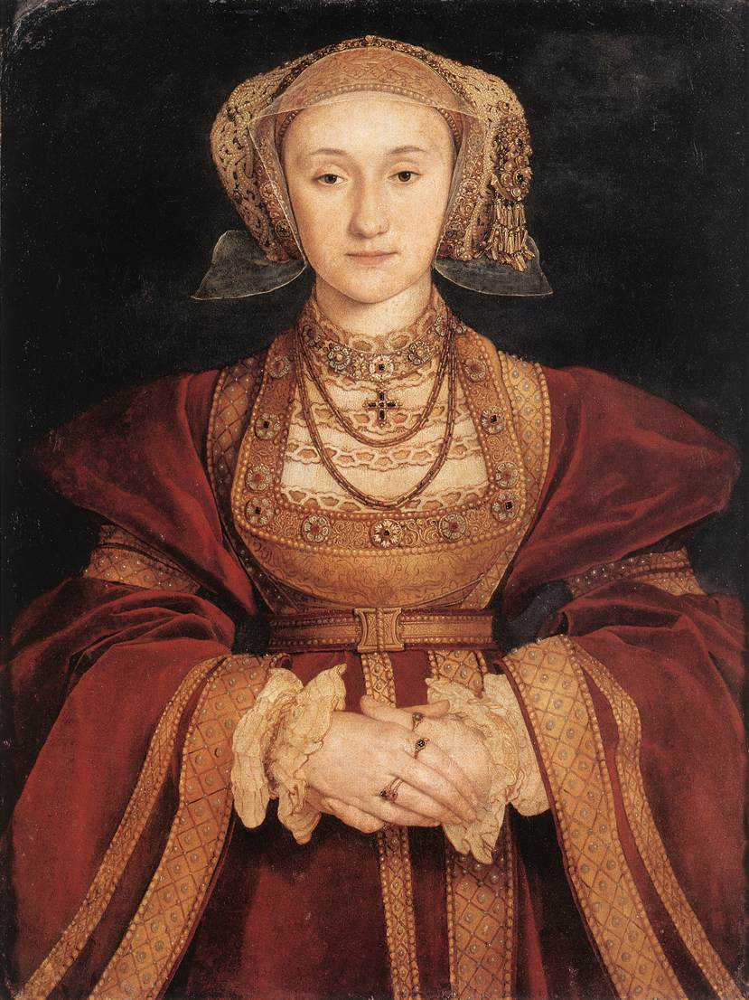
Anne of Cleves
Born September 22, 1515 to John III Duke of Cleves and Maria of Jülich-Berg
Married King Henry VIII on January 6, 1540
Was not suited for life in England
Henry VIII did not find her attractive and he began to look for another wife
The marriage was annulled July 1540
Died July 1557 at the age of 42
Notes:
Anne maintained a close relationship with Henry VIII and his family after their annulment
Was called the King’s Sister

Slide 7
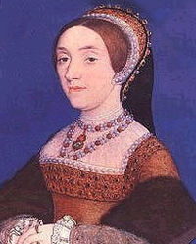
Catherine Howard
Born 1521 to Edmund Howard and Joyce Culpeper
Married King Henry VIII in July 1540
Only a year into their marriage rumors began to spread about Catherine’s infidelity
Executed for adultery February 13, 1542 at the age of 21
Notes:
The first cousin of Anne Boleyn

Slide 8
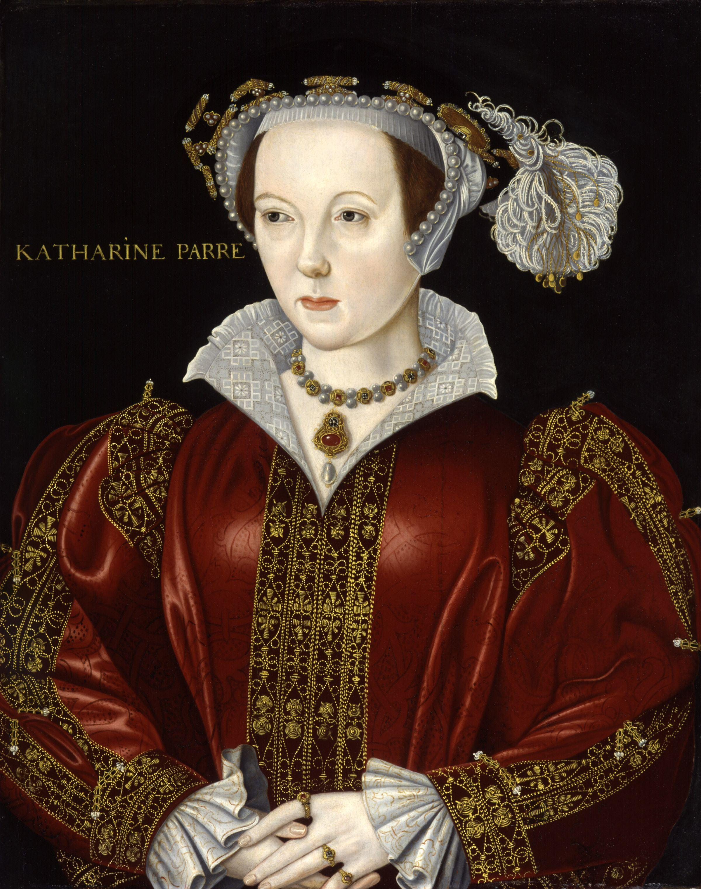
Catherine Parr
Born 1512 to Sir Thomas Parr and Maude Green
Twice widowed before she caught the attention of Henry VIII
Married Henry VIII on July 12, 1543
Became a widow for the third time when Henry VIII died January 28, 1547
Remarried again after Henry’s death to Thomas Seymour brother to the late Jane Seymour
Died September 7, 1548 shortly after giving birth at the age of 36
Notes:
Henry married her because he thought she would be a good stepmother to his three children

Slide 9
For continued reading….
Henry VIII
The Wives of Henry VIII

Slide 10
References
Anniina, J. (2012). King henry viii of England . Retrieved from http://www.luminarium.org/renlit/tudorbio.htm
Fry, P. S. (1999). Kings and Queens of England and Scotland . New York, NY: DK Publishing.
Weir , A. (1991). The Six Wives of Henry viii. New York, NY: Grove Press.

Slide 11
References
Pictures
https://www.google.com/search?q=catherine+of+aragon&safe=active&source=lnms&tbm=isch&sa=X&ei=Ych_Upz1Cejk4AO9tIDYAw&sqi=2&ved=0CAcQ_AUoAQ&biw=1366&bih=640#q=Henry+VIII+&safe=active&tbm=isch&facrc=_&imgdii=_&imgrc=NdzseNY0WcFXUM%3A%3BhuPH54uBEB7bmM%3Bhttp%253A%252F%252Fwww.luminarium.org%252Frenlit%252Fhenry8holyrood.jpg%3Bhttp%253A%252F%252Fwww.luminarium.org%252Frenlit%252Fhenry8face3.htm%3B992%3B1200
https://www.google.com/search?q=catherine+of+aragon&safe=active&source=lnms&tbm=isch&sa=X&ei=Ych_Upz1Cejk4AO9tIDYAw&sqi=2&ved=0CAcQ_AUoAQ&biw=1366&bih=640#facrc=_&imgrc=1bmqf0dWwg37nM%3A%3Bvg5dPfaG8ablEM%3Bhttp%253A%252F%252Fupload.wikimedia.org%252Fwikipedia%252Fcommons%252Fd%252Fd6%252FCatherine_aragon.jpg%3Bhttp%253A%252F%252Fen.wikipedia.org%252Fwiki%252FCatherine_of_Aragon%3B457%3B600
https://www.google.com/search?q=catherine+of+aragon&safe=active&source=lnms&tbm=isch&sa=X&ei=Ych_Upz1Cejk4AO9tIDYAw&sqi=2&ved=0CAcQ_AUoAQ&biw=1366&bih=640#q=anne+boleyn&safe=active&tbm=isch&facrc=_&imgdii=_&imgrc=ewUDvG7I2ubNlM%3A%3ByKU7dQSCGJ7uzM%3Bhttp%253A%252F%252Fwww.wga.hu%252Fart%252Fm%252Fmaster%252Fyunk_en%252Fboleyn.jpg%3Bhttp%253A%252F%252Fwww.wga.hu%252Ftours%252Fgerman%252Fwives.html%3B805%3B1037
https://www.google.com/search?q=catherine+of+aragon&safe=active&source=lnms&tbm=isch&sa=X&ei=Ych_Upz1Cejk4AO9tIDYAw&sqi=2&ved=0CAcQ_AUoAQ&biw=1366&bih=640#q=jane+seymour+henry+Viii&safe=active&tbm=isch&facrc=_&imgdii=_&imgrc=HhwsmP78TTmAQM%3A%3BL02123Q2ziMhgM%3Bhttp%253A%252F%252Fcreativecouples.net%252Fwp-content%252Fuploads%252F2011%252F08%252Fjane-seymour-portrait.jpg%3Bhttp%253A%252F%252Fcreativecouples.net%252Fliving-spaces-and-places%252Fhistorical-couples-king-henry-tudor-viii-jane-seymour%252F%3B396%3B497
https://www.google.com/search?q=catherine+of+aragon&safe=active&source=lnms&tbm=isch&sa=X&ei=Ych_Upz1Cejk4AO9tIDYAw&sqi=2&ved=0CAcQ_AUoAQ&biw=1366&bih=640#q=jane+seymour+henry+Viii&safe=active&tbm=isch&facrc=_&imgdii=_&imgrc=9Dalt0WquXGsWM%3A%3B_L95wlpQCp7UsM%3Bhttp%253A%252F%252Fupload.wikimedia.org%252Fwikipedia%252Fcommons%252F5%252F54%252FAnneCleves.jpg%3Bhttp%253A%252F%252Fen.wikipedia.org%252Fwiki%252FWives_of_Henry_VIII%3B829%3B1106
https://www.google.com/search?q=catherine+of+aragon&safe=active&source=lnms&tbm=isch&sa=X&ei=Ych_Upz1Cejk4AO9tIDYAw&sqi=2&ved=0CAcQ_AUoAQ&biw=1366&bih=640#q=catherine+howard+&safe=active&tbm=isch&facrc=_&imgrc=0439XpYLiQ8w1M%3A%3BKZZGADZCaz4z6M%3Bhttp%253A%252F%252Fupload.wikimedia.org%252Fwikipedia%252Fcommons%252Fthumb%252F3%252F32%252FHowardCatherine02.jpeg%252F200px-HowardCatherine02.jpeg%3Bhttp%253A%252F%252Fen.wikipedia.org%252Fwiki%252FCatherine_Howard%3B200%3B249
https://www.google.com/search?q=catherine+of+aragon&safe=active&source=lnms&tbm=isch&sa=X&ei=Ych_Upz1Cejk4AO9tIDYAw&sqi=2&ved=0CAcQ_AUoAQ&biw=1366&bih=640#q=catherine+parr+&safe=active&tbm=isch&facrc=_&imgrc=ZdlSTjJ0vHS4lM%3A%3BNLzydEb_YbLghM%3Bhttp%253A%252F%252Fupload.wikimedia.org%252Fwikipedia%252Fcommons%252F4%252F49%252FCatherine_Parr_from_NPG.jpg%3Bhttp%253A%252F%252Fen.wikipedia.org%252Fwiki%252FCatherine_Parr%3B2400%3B3042

